Slide 1

kuala lumpur
Google Colab Super Basic Instructions

Slide 2
Go to Google Colab website
https://colab.research.google.com

Slide 3
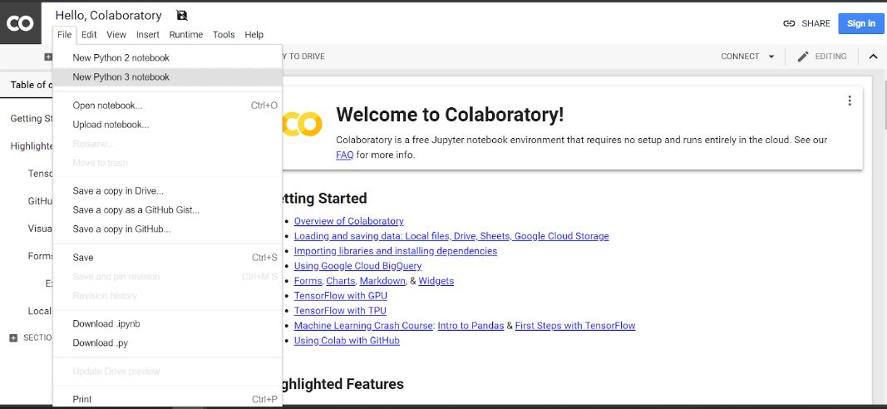
2. Open a new notebook

Slide 4
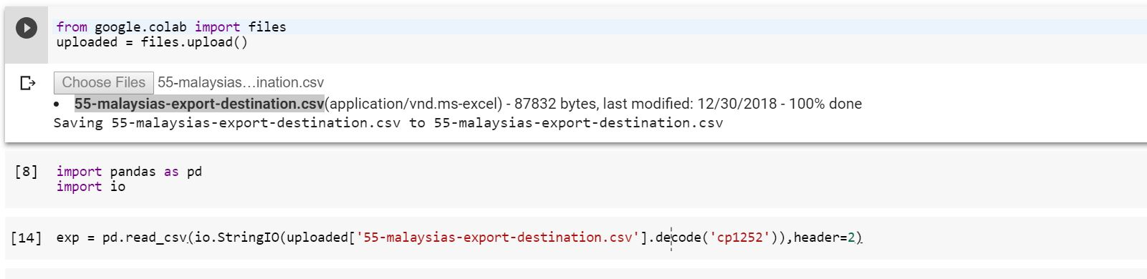
3. Load the intended dataset
Drag and drop the dataset intended

Slide 5
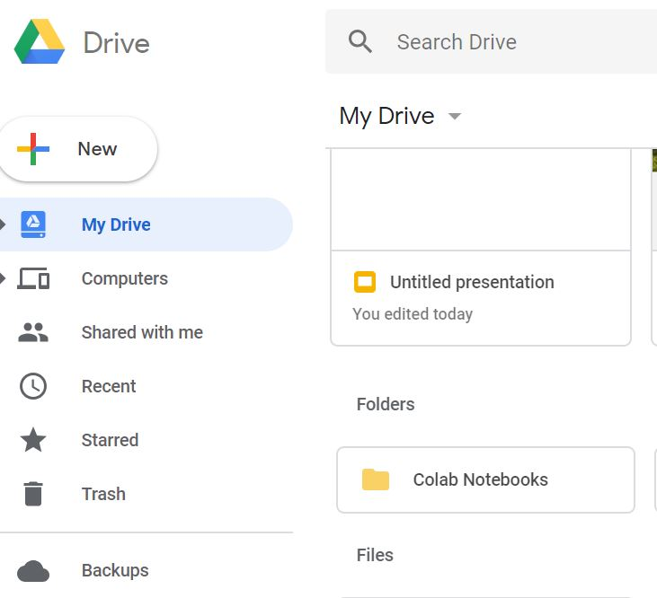
4. To load a .ipynb notebook
Save .ipynb notebook in
Colab Notebooks folder in your Google Drive

Slide 6
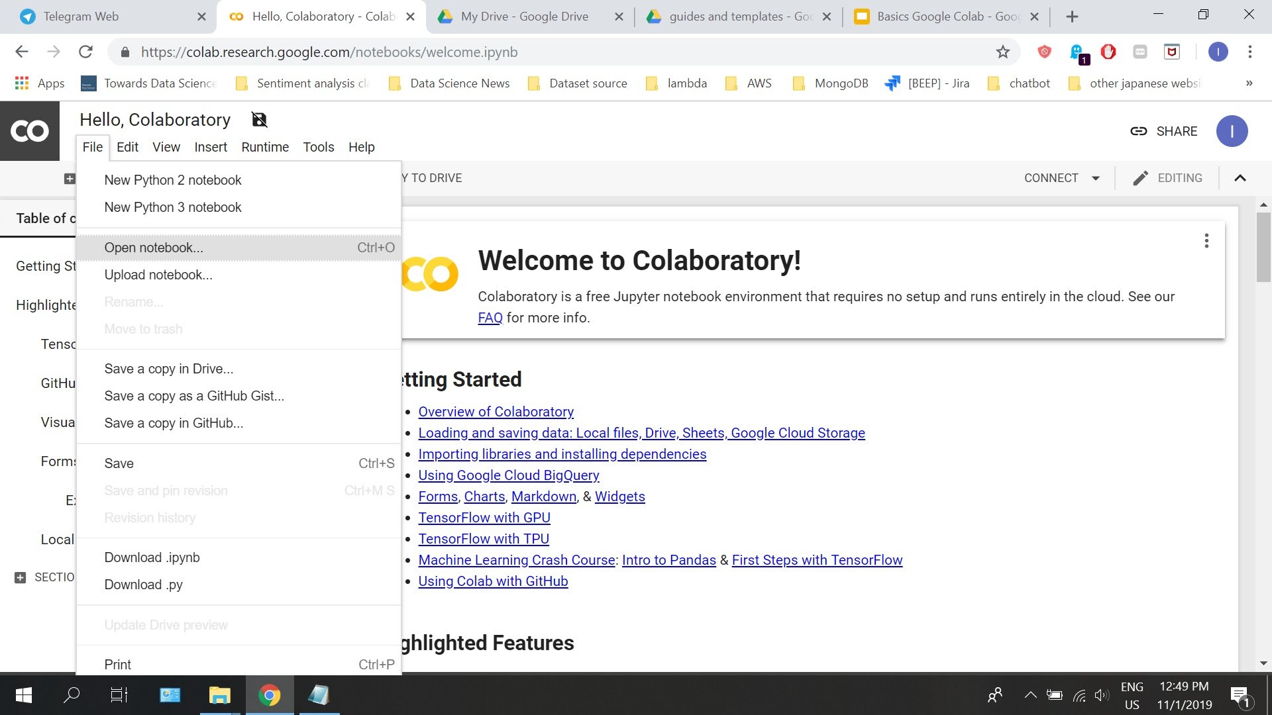
4. Choose Open Notebook

Slide 7
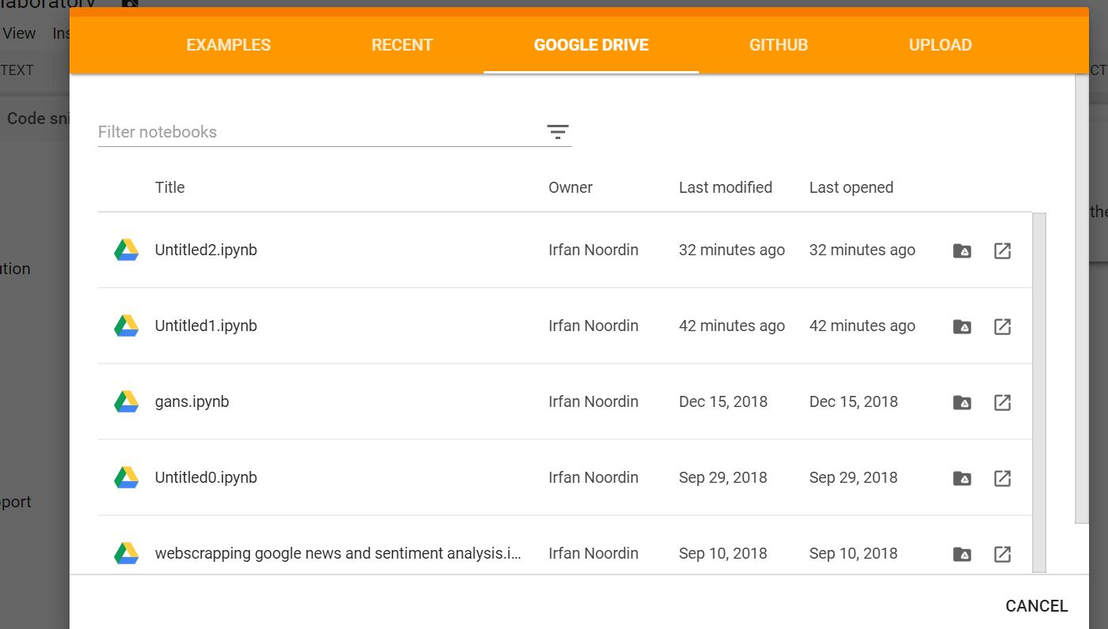
4. Choose Specific Notebook

